Slide 1





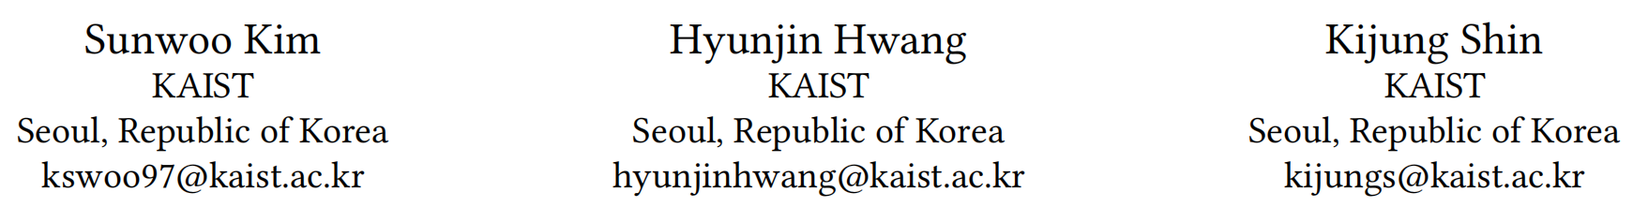





ATAI
Advanced Techniqueof Artificial Intelligence
ATAI
ChongqingUniversity _{AdvancedTechniqueof}
of Technology Artificial Intelligence
Chongqing University of
Technology
Chongqing University ^{ATAI}
_{of Technology} Advanced Techniqueof
Artificial Intelligence
Chongqing University of Technology
Chongqing University of Technology
PerPEFT_Personalized Parameter-Efficient Fine-Tuning of Foundation Models for Multimodal Recommendation
Code: https://github.com/kswoo97/PerPEFT.
2026.4.5
—— WWW_2026
Reported by Yang Hu
1

Slide 2

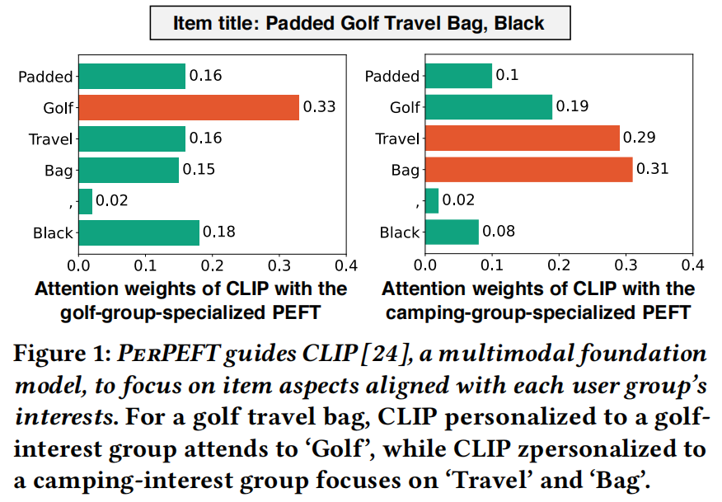
ATAI
AdvancedTechniqueof
Artificial Intelligence
ATAI
ChongqingUniversity _{AdvancedTechniqueof}
of Technology Artificial Intelligence
ChongqingUniversity of Technology
Motivation
Pre-trained multimodal foundation models are not originally trained for recommendation tasks, recent works efficiently adapt them via parameter-efficient fine-tuning(PEFT). However, even with PEFT, item embeddings from multimodal foundation models remain user-blind: item embeddings are not conditioned on user interests, despite the fact that users with diverse interests attend to different item aspects.

Slide 3

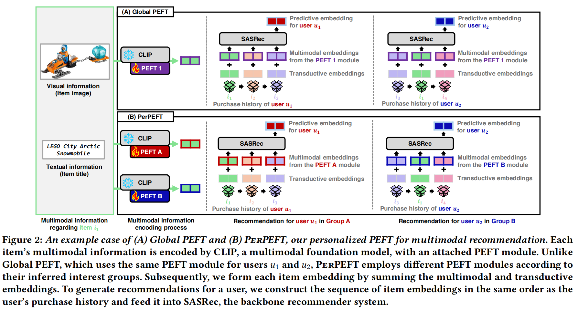
ChongqingUniversity of Technology
ATAI
AdvancedTechniqueof
Artificial Intelligence
ATAI
ChongqingUniversity _{AdvancedTechniqueof}
of Technology Artificial Intelligence
Overview

Slide 4
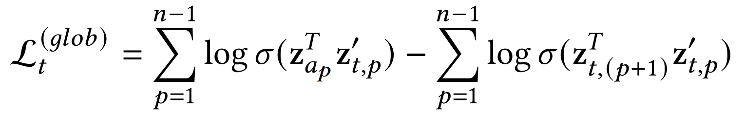
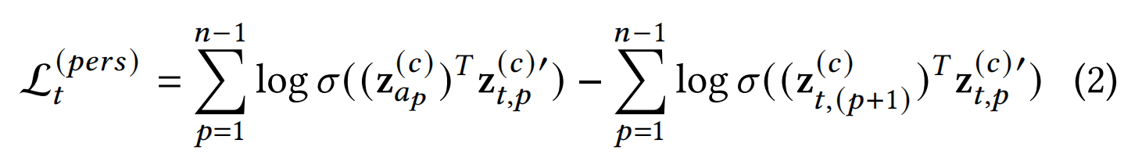
ChongqingUniversity of Technology
ATAI
AdvancedTechniqueof
Artificial Intelligence
ATAI
ChongqingUniversity _{AdvancedTechniqueof}
of Technology Artificial Intelligence
Method
(1)
(2)

Slide 5

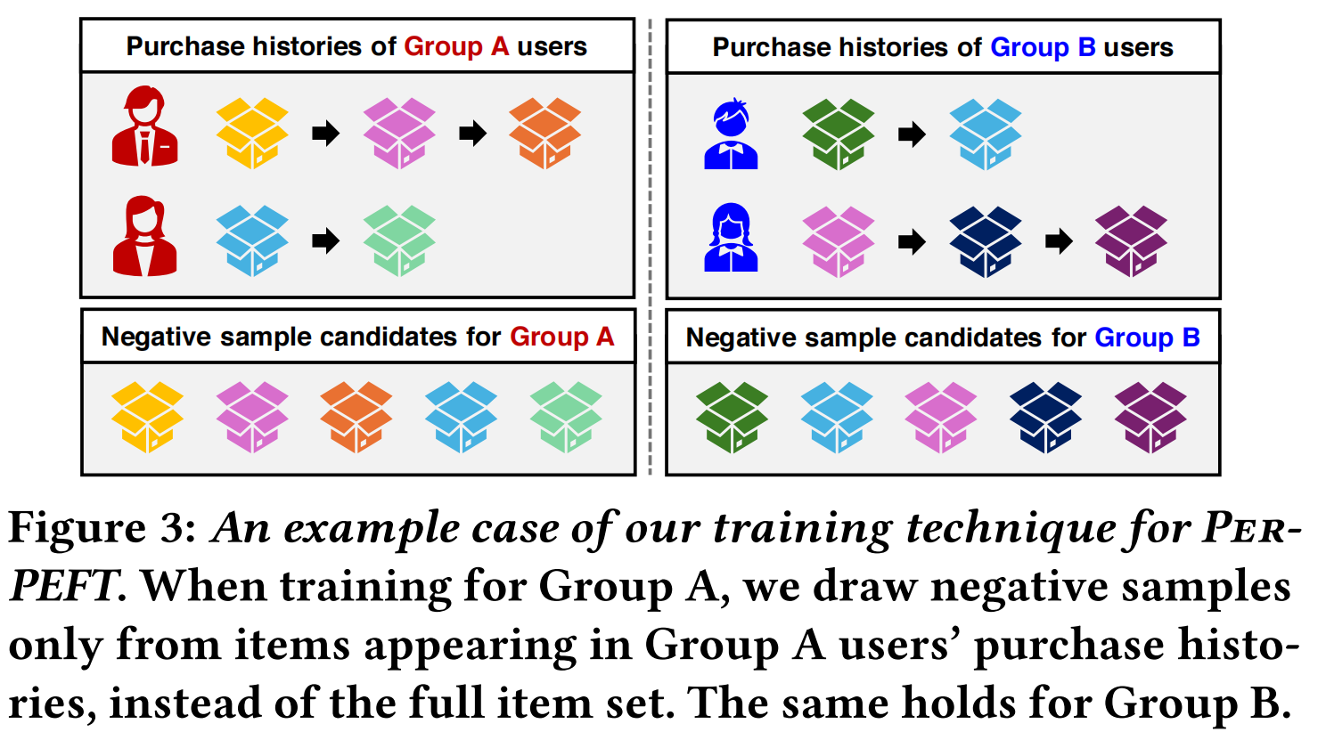
ATAI
AdvancedTechniqueof
Artificial Intelligence
ATAI
ChongqingUniversity _{AdvancedTechniqueof}
of Technology Artificial Intelligence
ChongqingUniversity of Technology
Experiments

Slide 6
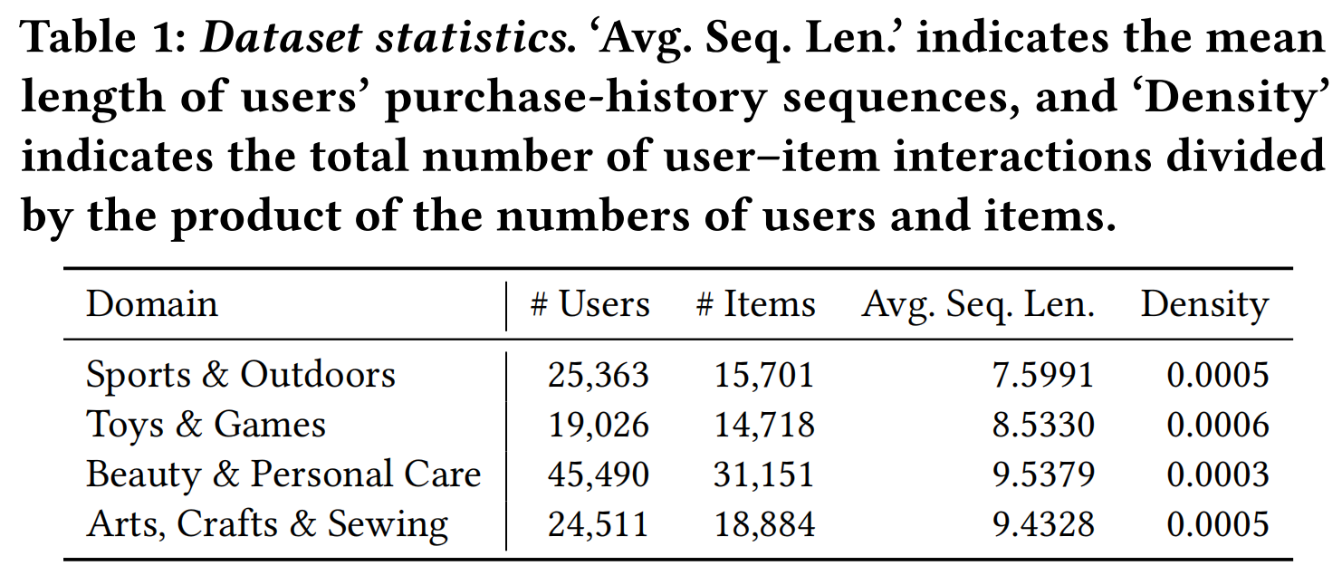
ATAI
AdvancedTechniqueof
Artificial Intelligence
ATAI
ChongqingUniversity _{AdvancedTechniqueof}
of Technology Artificial Intelligence
ChongqingUniversity of Technology
Experiments

Slide 7
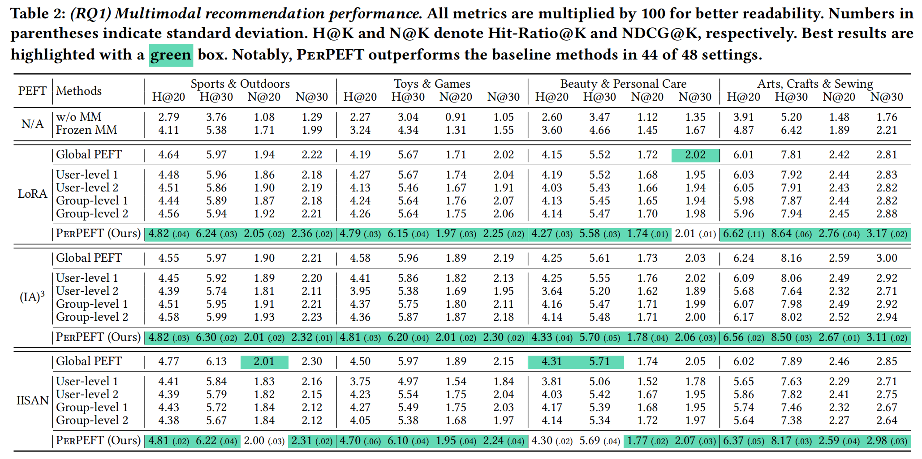
ATAI
AdvancedTechniqueof
Artificial Intelligence
ATAI
ChongqingUniversity _{AdvancedTechniqueof}
of Technology Artificial Intelligence
ChongqingUniversity of Technology
Experiments

Slide 8
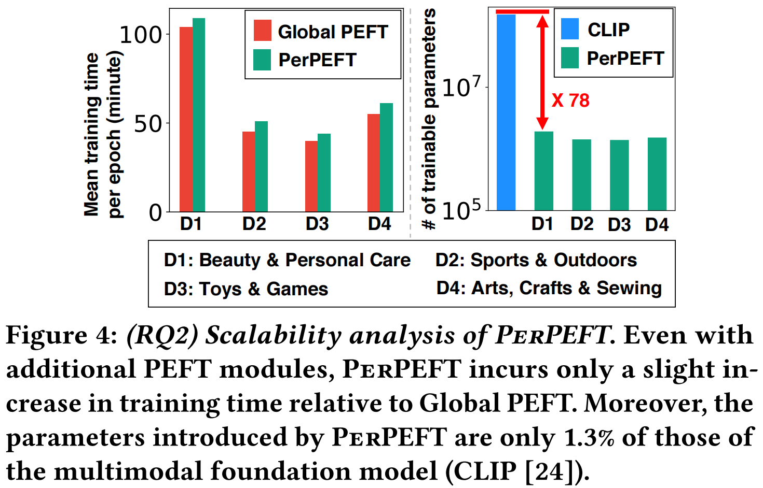
ATAI
AdvancedTechniqueof
Artificial Intelligence
ATAI
ChongqingUniversity _{AdvancedTechniqueof}
of Technology Artificial Intelligence
ChongqingUniversity of Technology
Experiments

Slide 9
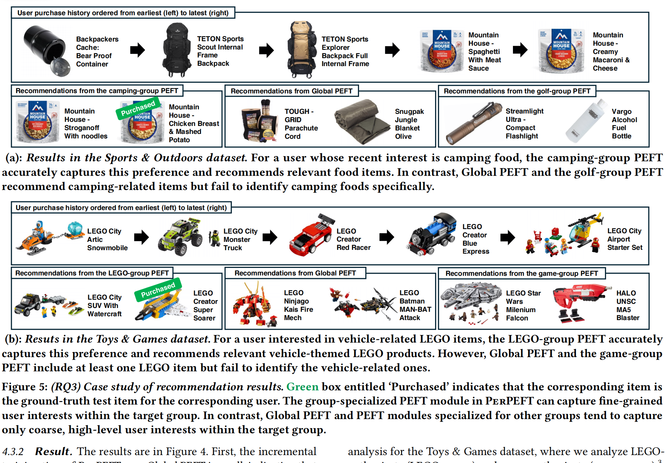
ATAI
AdvancedTechniqueof
Artificial Intelligence
ATAI
ChongqingUniversity _{AdvancedTechniqueof}
of Technology Artificial Intelligence
ChongqingUniversity of Technology
Experiments

Slide 10
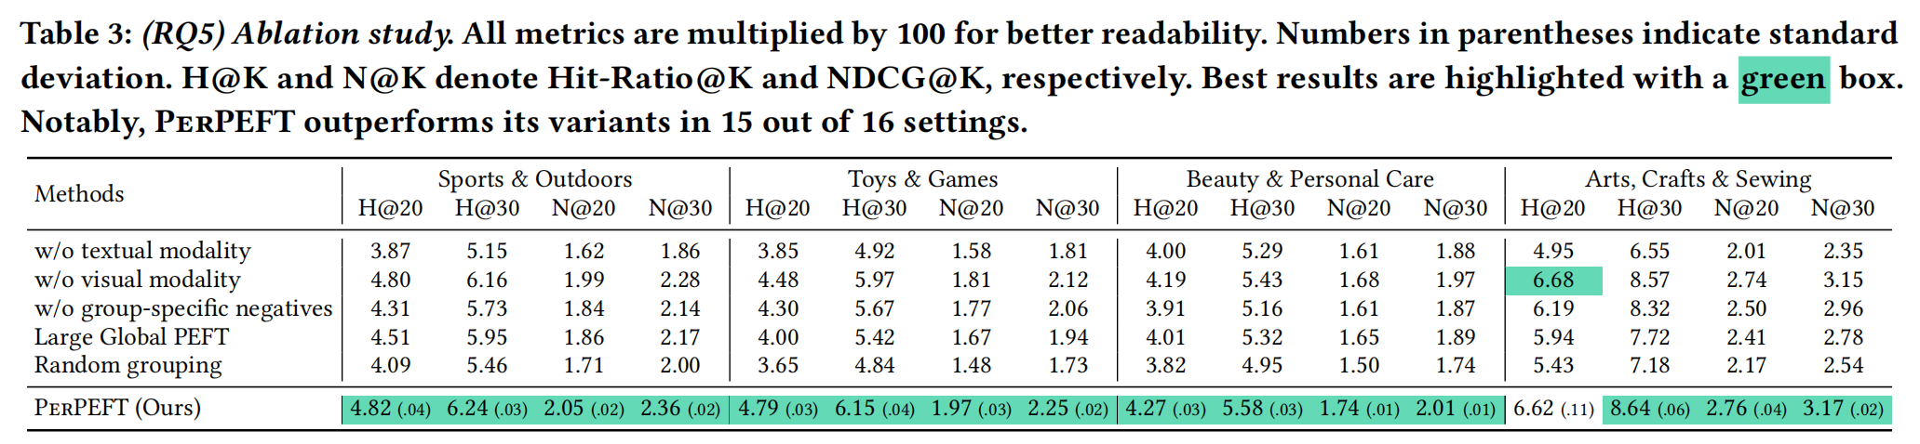
ATAI
AdvancedTechniqueof
Artificial Intelligence
ATAI
ChongqingUniversity _{AdvancedTechniqueof}
of Technology Artificial Intelligence
ChongqingUniversity of Technology
Experiments

Slide 11
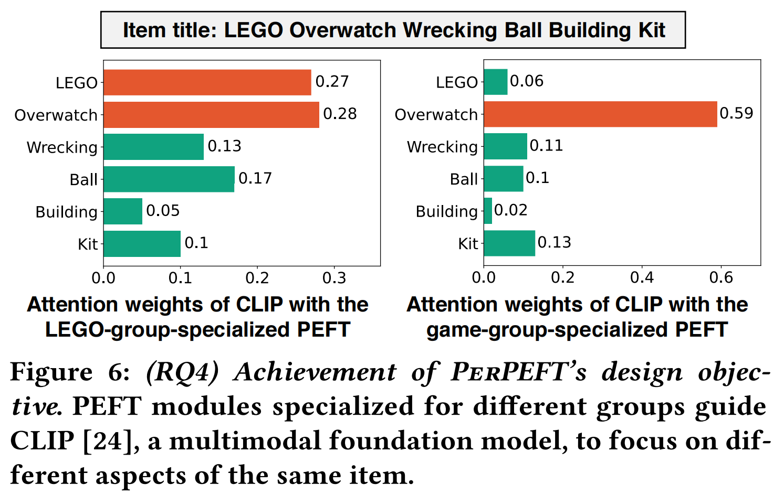
ATAI
AdvancedTechniqueof
Artificial Intelligence
ATAI
ChongqingUniversity _{AdvancedTechniqueof}
of Technology Artificial Intelligence
ChongqingUniversity of Technology
Experiments

Slide 12
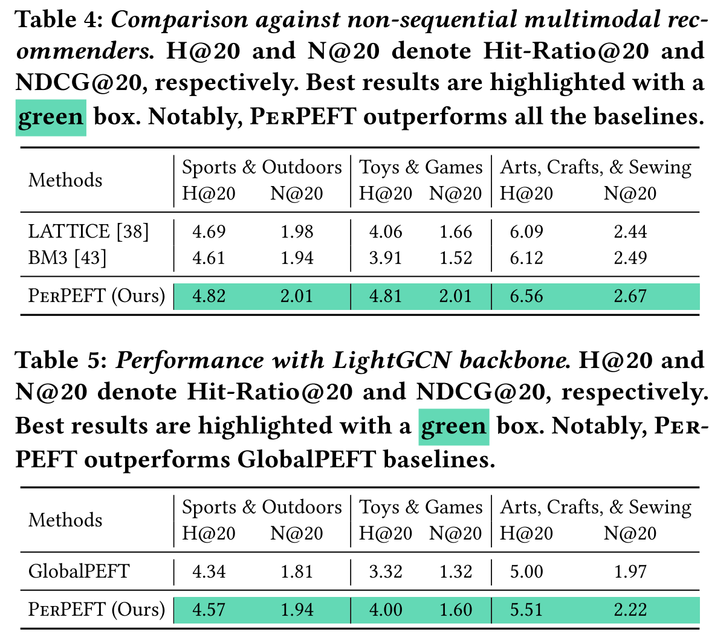
ATAI
AdvancedTechniqueof
Artificial Intelligence
ATAI
ChongqingUniversity _{AdvancedTechniqueof}
of Technology Artificial Intelligence
ChongqingUniversity of Technology
Experiments

Slide 13
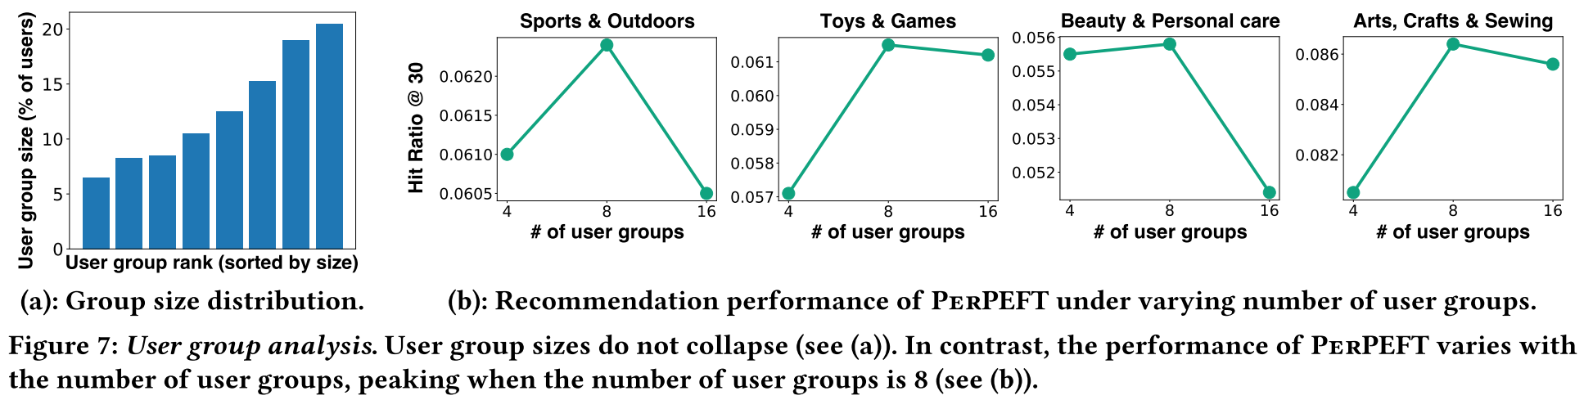
ATAI
AdvancedTechniqueof
Artificial Intelligence
ATAI
ChongqingUniversity _{AdvancedTechniqueof}
of Technology Artificial Intelligence
ChongqingUniversity of Technology
Experiments

Slide 14
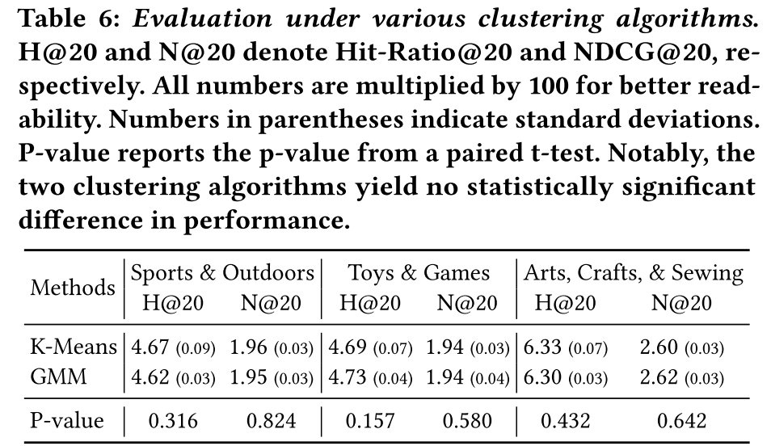
ATAI
AdvancedTechniqueof
Artificial Intelligence
ATAI
ChongqingUniversity _{AdvancedTechniqueof}
of Technology Artificial Intelligence
ChongqingUniversity of Technology
Experiments

Slide 15
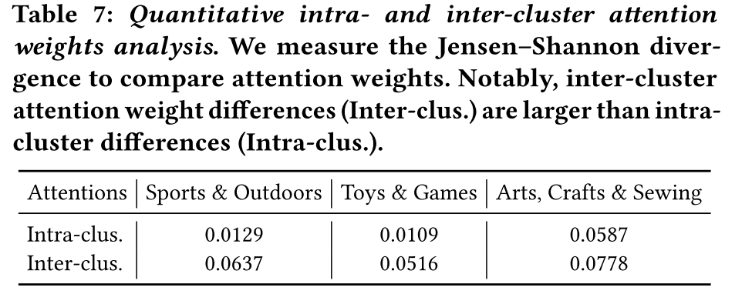
ATAI
AdvancedTechniqueof
Artificial Intelligence
ATAI
ChongqingUniversity _{AdvancedTechniqueof}
of Technology Artificial Intelligence
ChongqingUniversity of Technology
Experiments

Slide 16
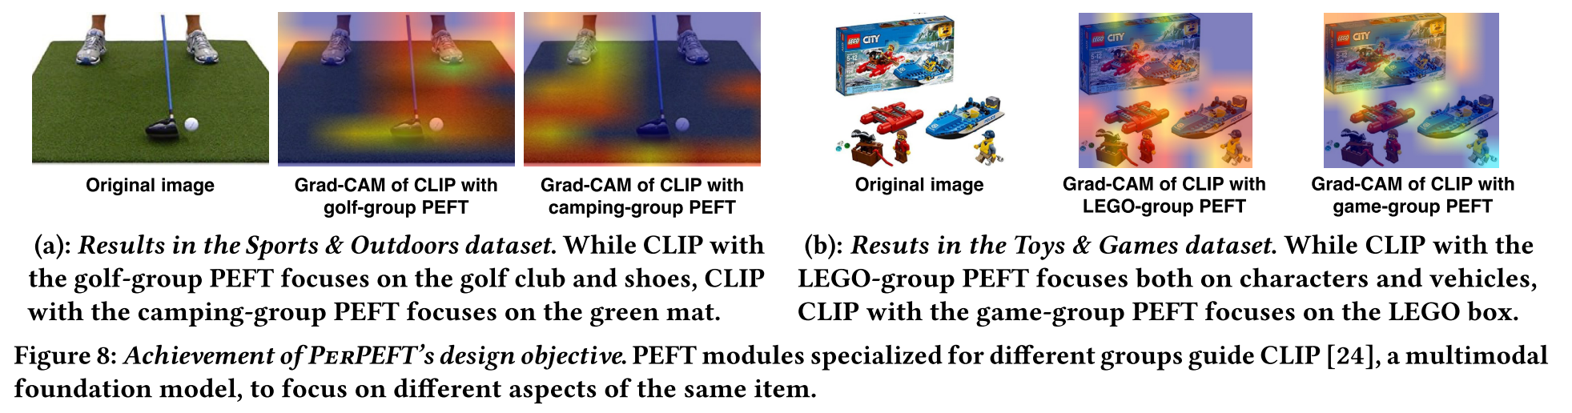
ATAI
AdvancedTechniqueof
Artificial Intelligence
ATAI
ChongqingUniversity _{AdvancedTechniqueof}
of Technology Artificial Intelligence
ChongqingUniversity of Technology
Experiments

Slide 17
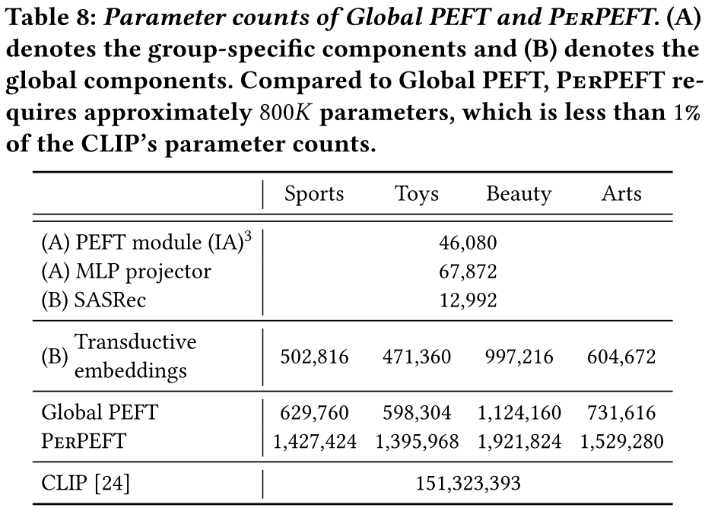
ATAI
AdvancedTechniqueof
Artificial Intelligence
ATAI
ChongqingUniversity _{AdvancedTechniqueof}
of Technology Artificial Intelligence
ChongqingUniversity of Technology
Experiments

Slide 18
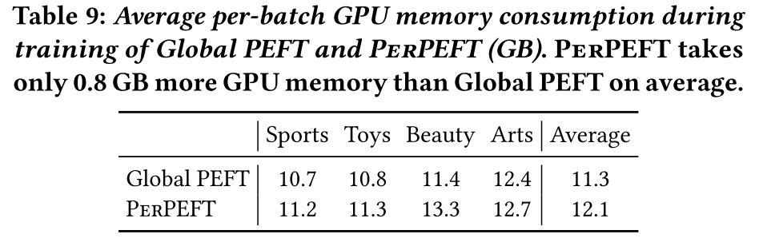
ATAI
AdvancedTechniqueof
Artificial Intelligence
ATAI
ChongqingUniversity _{AdvancedTechniqueof}
of Technology Artificial Intelligence
ChongqingUniversity of Technology
Experiments

Slide 19


ChongqingUniversity of Technology
ATAI
AdvancedTechniqueof
Artificial Intelligence
ATAI
ChongqingUniversity _{AdvancedTechniqueof}
of Technology Artificial Intelligence
Thanks!

